Slide 1
Fourier Series and its Applications
Renny Harlin D – CB.SC.U4AIE23334
Neha R Menon – CB.SC.U4AIE23324
Dhruv A P – CB.SC.U4AIE23302
Malapati Kalyan Rohit – CB.SC.U4AIE23318

Slide 2


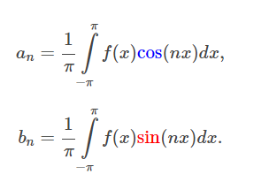
Fourier Series
Fourier series can be explained as expressing a periodic curve as a sum of sines and cosines
The coefficients a_{n} and b_{n} are the amplitudes of the sines and cosines respectively at the n^{th} harmonic frequency

Slide 3
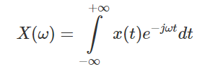

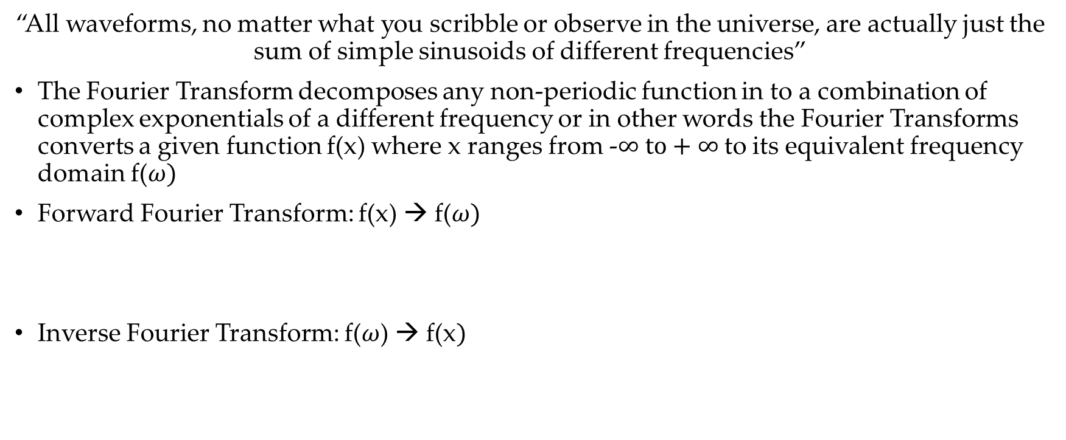
Fourier Transform
“All waveforms, no matter what you scribble or observe in the universe, are actually just the sum of simple sinusoids of different frequencies”
The Fourier Transform decomposes any non-periodic function in to a combination of complex exponentials of a different frequency or in other words the Fourier Transforms converts a given function f(x) where x ranges from -$∞ to+∞$to its equivalent frequency domain f($ω)$
Forward Fourier Transform: f(x) → f($ω)$
Inverse Fourier Transform: f($ω$) → f(x$)$

Slide 4
Fourier Series
Any periodic function can be expressed a series of sines and cosines

Slide 5
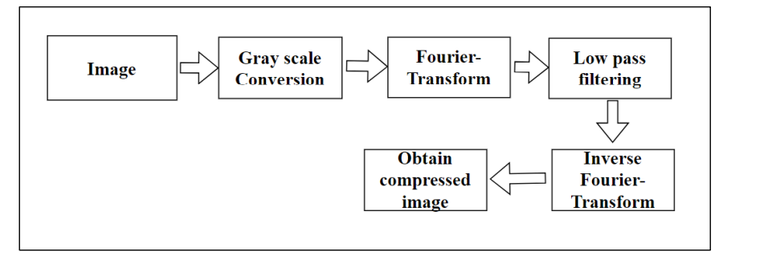
Image Compression

Slide 6
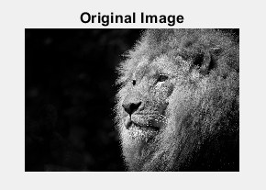
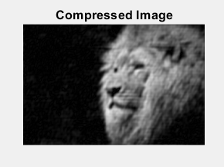
Image Compression
Remove high frequency components by using high pass filter

Slide 7
Feature Extraction
The process of identifying and extracting meaningful patterns, structures, or attributes within the image.
Image
Fourier Transform
Grayscale Conversion
Magnitude Spectrum
Feature Detection
High-Pass Filtering
Inverse Fourier Transform

Slide 8
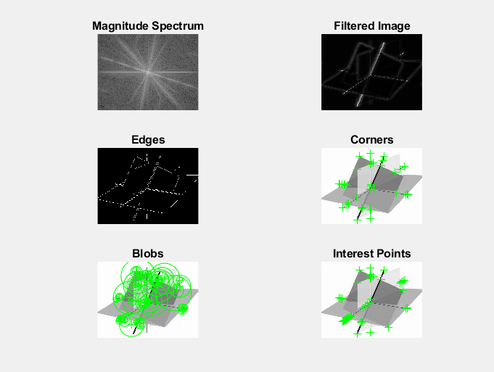
Outcomes

Slide 9
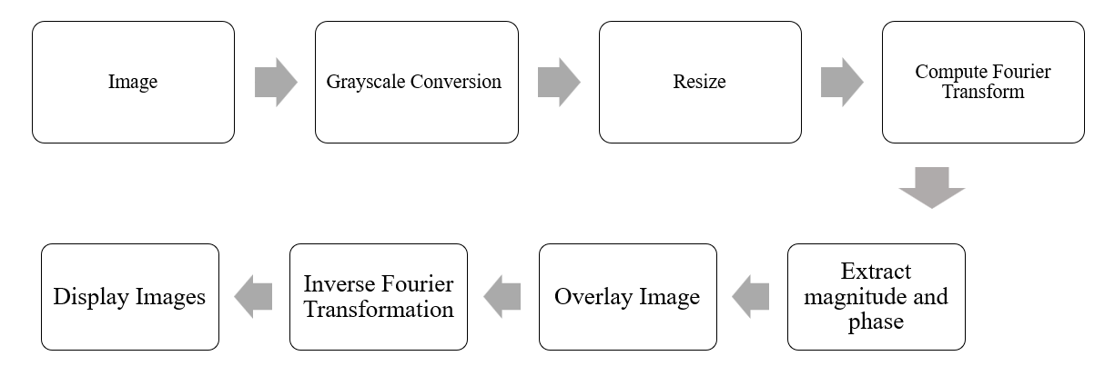
Image Overlay System
An image overlay system is a technology used to superimpose one image onto another.

Slide 10
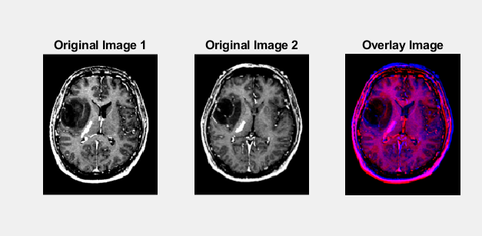
Outcomes

Slide 11
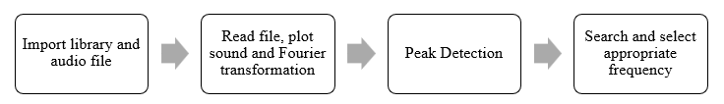
Music Detection System
A music note detection system involves identifying and interpreting musical notes from audio signals. It identifies the different notes being played based on their frequencies

Slide 12
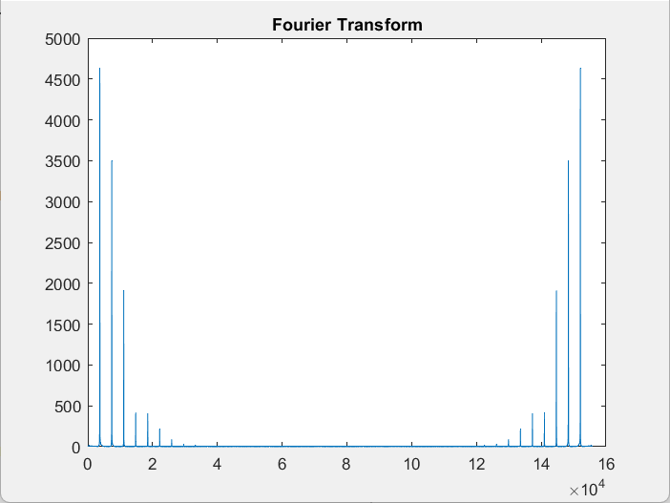
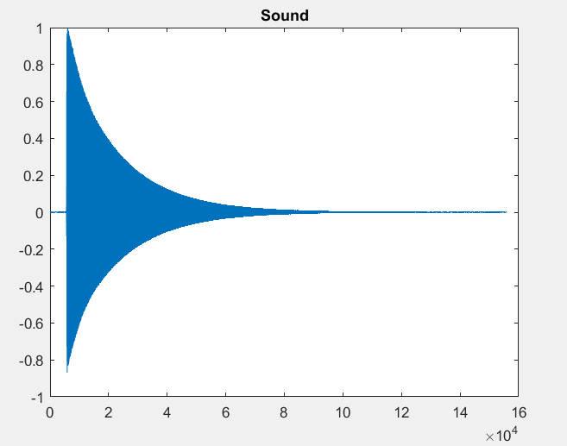

Outcomes

Slide 13
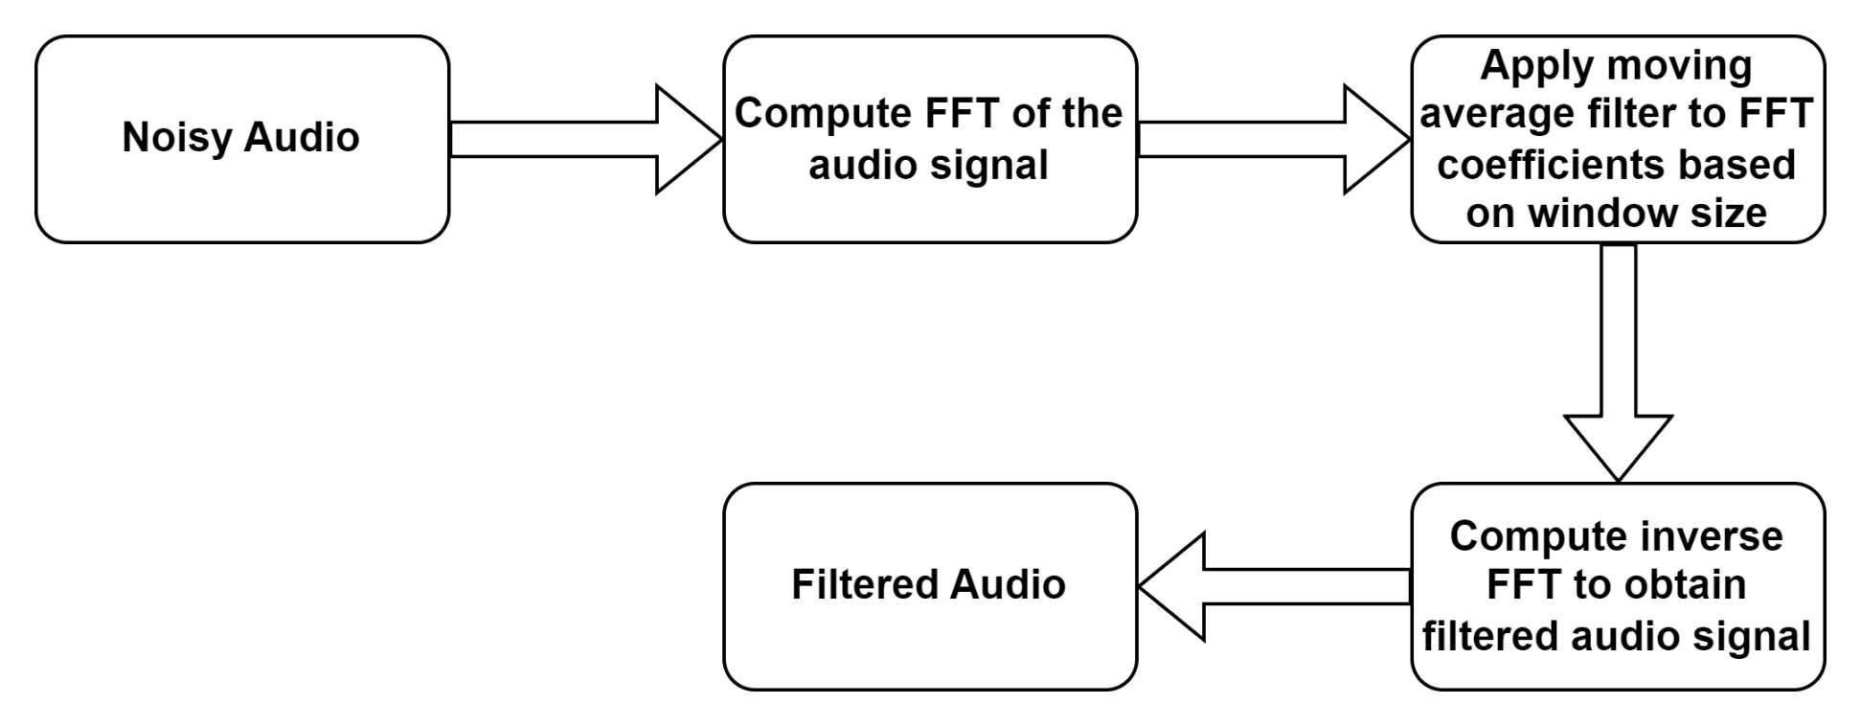
Noise Reduction
One of the main applications of Fourier transform is Noise Reduction
The main principle of Noise Reduction lies on the key fact that the dominant modes or sounds lies in the region of higher amplitude in the frequency spectrum of the FFT

Slide 14
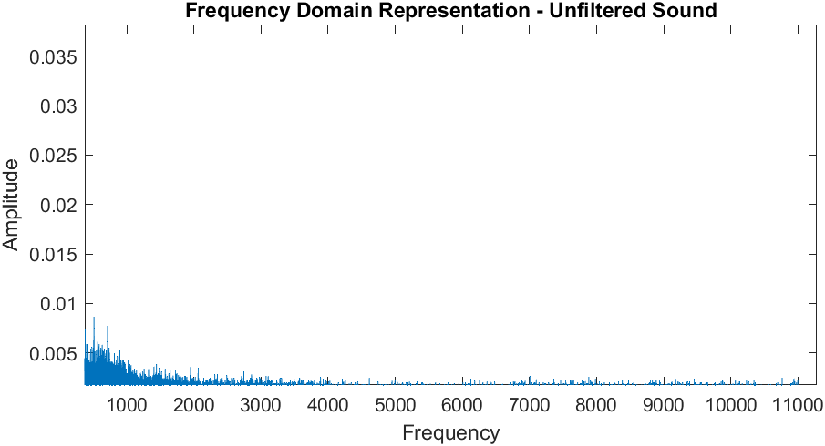
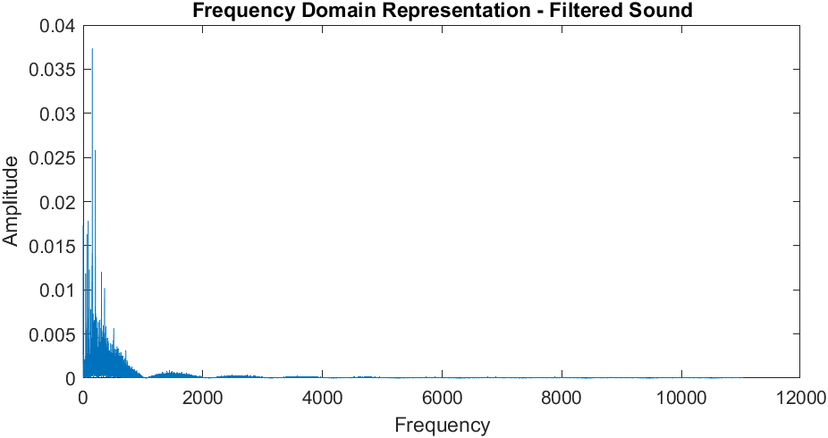
Frequency Waveforms

Slide 15
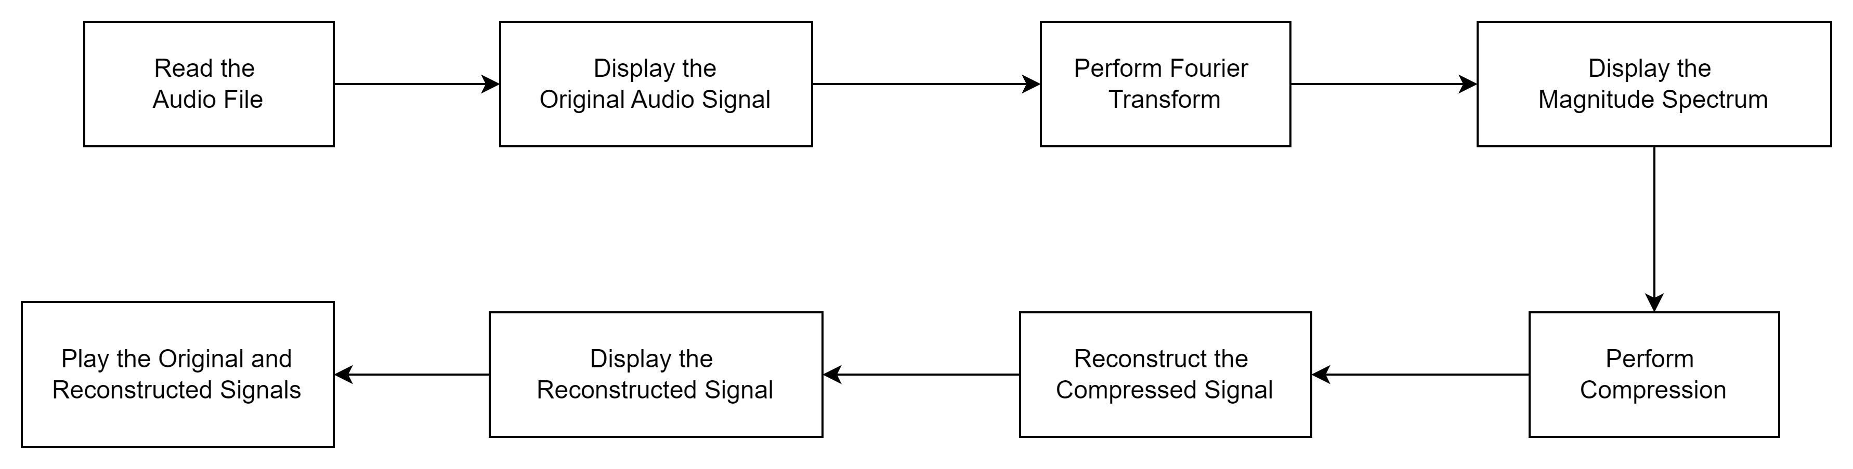
Sound Compression
The application used here to compress the audio is FFT (Fast Fourier Transform)

Slide 16
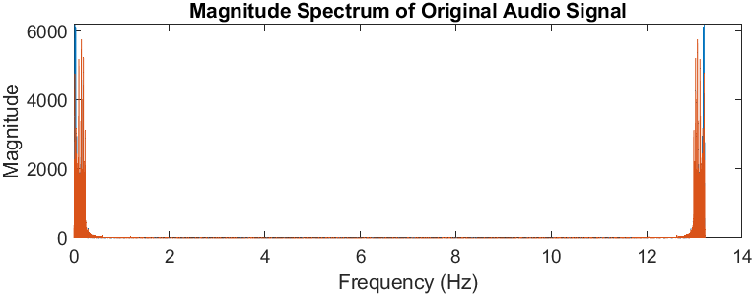
Original Audio Signal

Slide 17
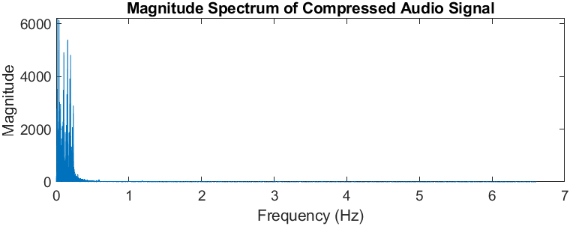
Compressed Audio Signal

Slide 18
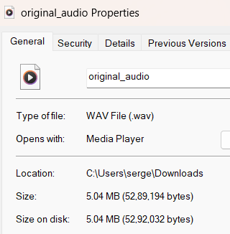
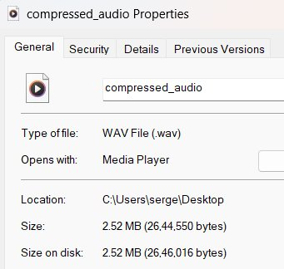
Storage size comparison

Slide 19
FFT in CNN

Slide 20
Convolutional Neural Networks
Convolutional neural network is predominantly used in feature extraction during training
The common sequence of CNNs are:
Convolutional layer
ReLU Activation
Max pooling layer
Dense Connected layer
Convolutional layer works with the help of a kernel matrix (weights) to create a feature mask

Slide 21
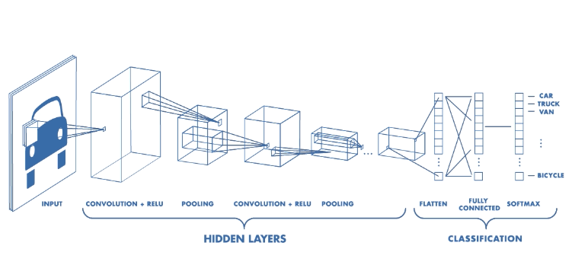
Convolutional Neural Network

Slide 22
FFT In CNN
Standard Convolution layers take N^2 operations
FFT Convolution layers only take NlogN operations
Better at feature extraction than standard CNN

Slide 23
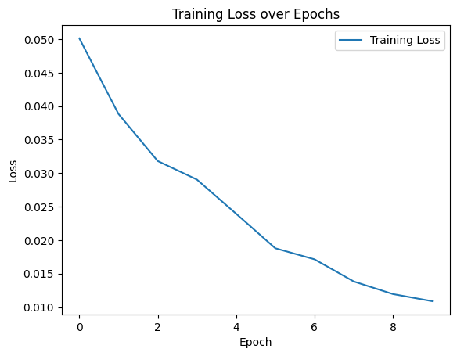
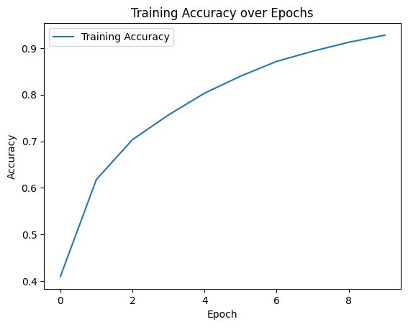
Results

Slide 24
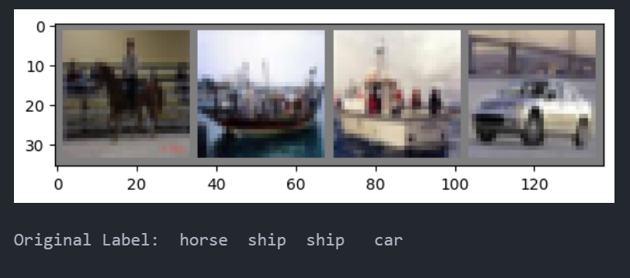

Random Experiments

Slide 25
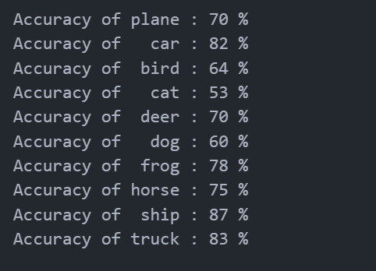

Accuracy Calculations

